Slide 1
COS110: EO1 Bootcamp
Session 1

Slide 2
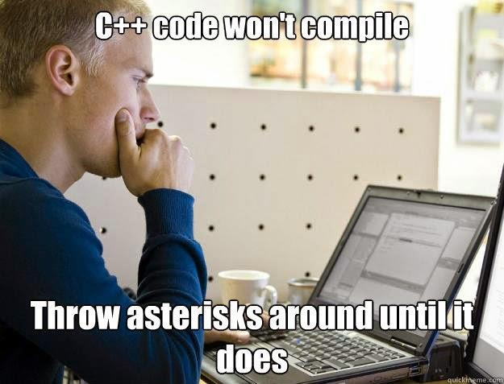
Admin
Ask questions
Participate in activities
Make notes
Have fun
Notes:
Slides will be released after the session

Slide 3
Objectives
Pointers
Dynamic Memory
Arrays
Quiz

Slide 4
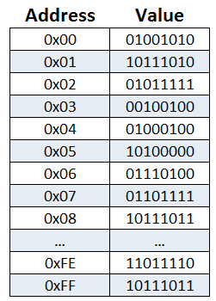
Pointers
What are they?
An address to something in memory
int* a

Slide 5


Pointers
Lets abstract the idea a bit
Do not write this in your 122 assignments please :)
Let us assume the following:
Pointers = portals
Memory location = plot of land

Slide 6
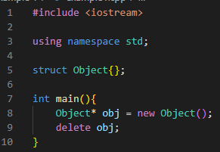
Example 1
What is the portal?
What is the plot of land
Notes:
The obj
A block in memory for a single Object
Keyword new

Slide 7

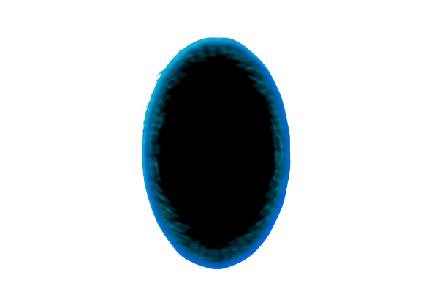


Example 1
Notes:
Squirrel is the program
Purple place is the shop
Plot of land is plot of land

Slide 8
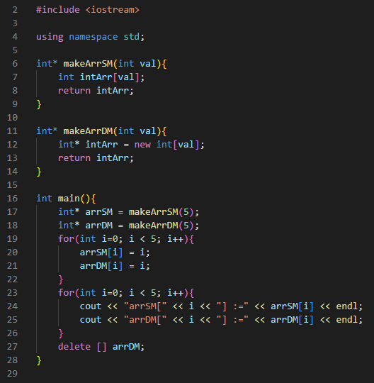


Dynamic memory
What is dynamic memory?
Memory allocated and deallocated during runtime
Why is this useful? Why can’t we just use static memory
Given this code will it compile?
Given this code will it run?
Given this code will it exit successfully?
WHY?

Slide 9
Dynamic Memory - Behind the curtains what going on?
Object has a size of 1 byte
Program asks OS for 1 byte of memory
OS returns a pointer to the byte of memory
Use the memory
Program gives the memory back to the OS
OS marks this memory as available for future use

Slide 10

Dynamic Memory
Lets abstract the idea a bit
Do not write this in your 122 assignments please :)
Let us assume the following:
Pointers = portals
Memory location = plot of land
OS = shop renting plots of land

Slide 11

Example 2
Notes:
Squirrel is the program
Purple place is the shop
Plot of land is plot of land
Shop is the purble place

Slide 12
Dynamic Memory
What happens when you don't deallocate memory?

Slide 13
Example 3
Notes:
Squirrel is the program
Purple place is the shop
Plot of land is plot of land
Shop is the purble place

Slide 14
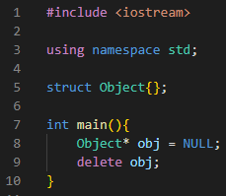
Dynamic Memory
What happens when you deallocate a null?

Slide 15
Example 4
Notes:
Squirrel is the program
Purple place is the shop
Plot of land is plot of land
Shop is the purble place

Slide 16
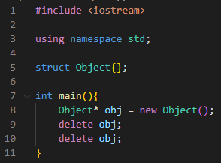
Dynamic Memory
What happens when you deallocate something that has been deallocated before?

Slide 17
Example 5
Notes:
Squirrel is the program
Purple place is the shop
Plot of land is plot of land
Shop is the purble place

Slide 18
Arrays
int* arr
index | 0 | 1 | 2 | 3 | 4 | 5 | 6 | 7 | 8
Offset from origin | 0 | originPtr +1 | originPtr + 2 | originPtr + 3 | originPtr + 4 | originPtr + 5 | originPtr + 6 | originPtr + 7 | originPtr + 8
value | 5 | 5 | 1 | 7 | 5 | 1 | 7 | 4 | 3

Slide 19

Example 6
1
2
0
3
Notes:
Squirrel is the program
Purple place is the shop
Plot of land is plot of land
Shop is the purble place

Slide 20
2D Arrays
index | 0 | 1 | 2 | 3 | 4 | 5 | 6 | 7 | 8
Offset from origin | 0 | originPtr +1 | originPtr + 2 | originPtr + 3 | originPtr + 4 | originPtr + 5 | originPtr + 6 | originPtr + 7 | originPtr + 8
value

Slide 21
Example 7
1
2
0
3
0
1
2
0
Notes:
Squirrel is the program
Purple place is the shop
Plot of land is plot of land
Shop is the purble place

Slide 22
MD-Array
Exercise:
Draw a graphical representation of a 5D array

Slide 23
1D Dynamic Array of static objects
Declare the array using keyword new
Populate the array as needed
Use array
Deallocate memory
If the array contained ints what would the data type be?

Slide 24
2D Dynamic Array of static objects
Declare the outer array using keyword new
Populate the outer arrays with new sub arrays using previous method
Use array
Deallocate each sub array
Deallocate the main array
If the array contained ints what would the data type be?

Slide 25
1D Dynamic Array of dynamic objects
Declare the array using keyword new
Populate the array as needed with dynamic objects
Use array
Deallocate each element in the array
Deallocate the array
If the array contained ints what would the data type be?

Slide 26
2D Dynamic Array of Dynamic objects
Write the code down to create and deallocate the array if it consisted of dynamic ints

Slide 27
Quiz: https://forms.gle/G8cSMgrzrLyyNE828

Slide 28
Questions

Slide 29
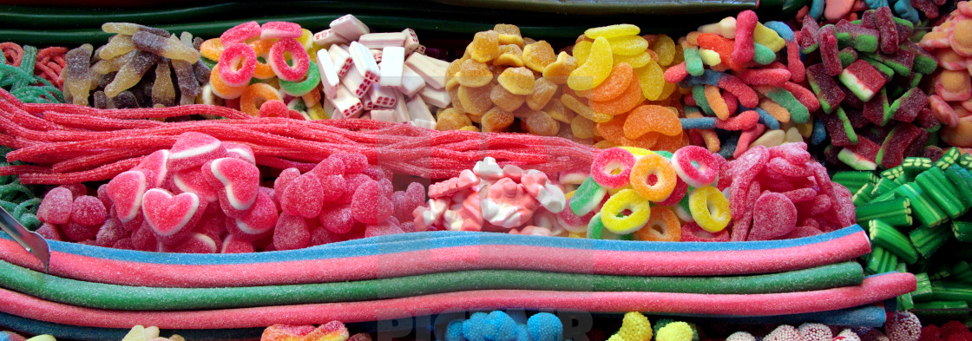
Break 1 - Sweeties time

Slide 30
COS110: EO1 Bootcamp
Session 2

Slide 31
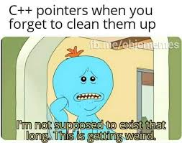
Admin
Ask questions
Participate in activities
Make notes
Have fun
Notes:
Slides will be released after the session

Slide 32
Content
Introduction to classes
Component of a class
Relating a class to a UML Diagram

Slide 33
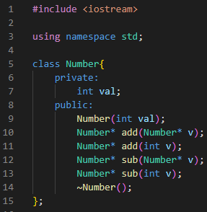
What is a class
Why do we want classes?
Grouping values and functions together.
Class:
Like a struct (allows bundling of related variables), but variables and functions in the class can have different properties than in a struct

Slide 34
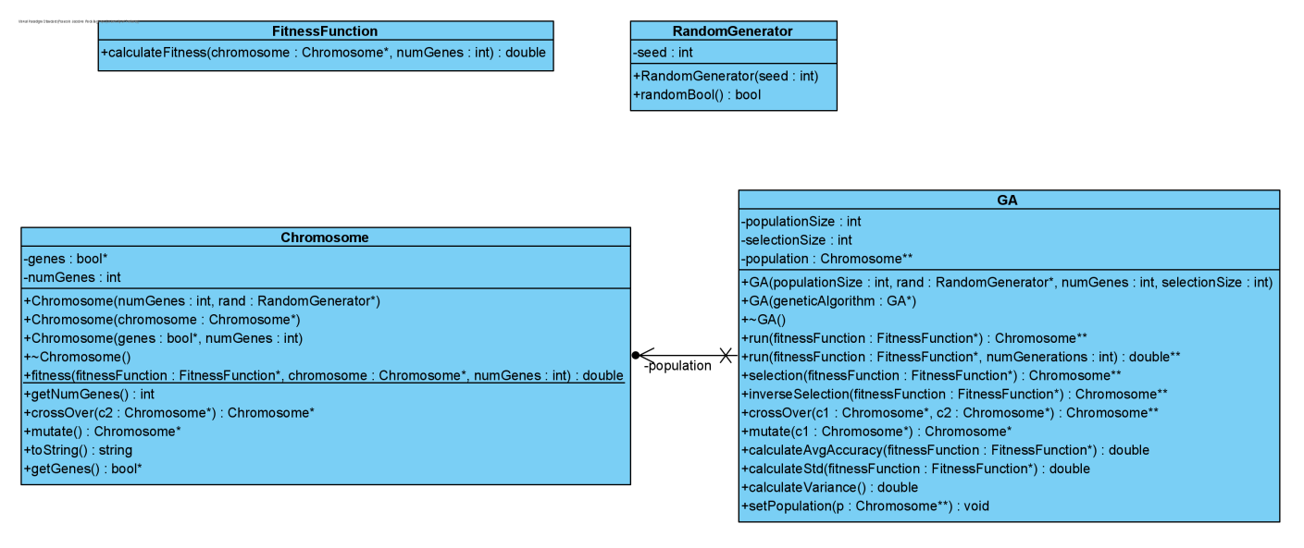
UML
Unified Modeling Language
Way to describe classes and relationships between classes in a formal way

Slide 35
Class vs Object
What is the difference?
Class has structure but no state.
State means values
Object has structure and state.
Lamens terms
A class describes how the object be composed.
An object is a class that has values attached to it

Slide 36
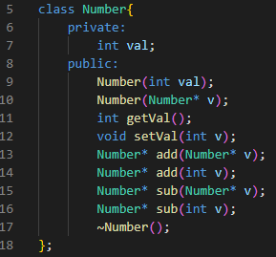
Components of class
Class name
Accessibility specifier
Member
Methods

Slide 37
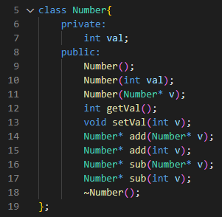
Components of class
What are the other names for getters and setters
Default constructor
Parameterized constructor
Getter
Copy Constructor
Setter
Destructor
Notes:
Getter = accessor
Setter = mutator

Slide 38
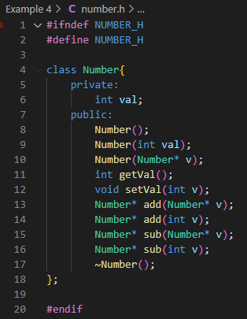
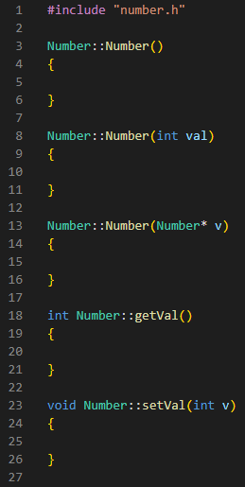
Header vs Implementation
Header
.h file
Contains class definition
Remember your include guards
Implementation file
.cpp file
Contains implementation
Scope resolution operator (::)

Slide 39
Purpose of constructors and destructors
Purpose of constructor?
To create and initialize all the members of the object
Purpose of destructor?
Deallocate all the required dynamically allocated memory

Slide 40
Constructor overloading
Works the same as normal function overloading
A functions uniqueness is determined by?
Parameters

Slide 41
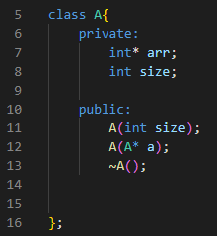
Copy constructor
Used instantiate a new object with a passed in object of the same type.
Using this class implement the copy constructor

Slide 42

Static members
What are static members
Members shared by all objects of the same class
Can static functions be called without creating an object of that class?
Yes
Can static members be initialized inside of the class?
No
Where have you seen a static function before?
Assignment 1
How would you call this function?

Slide 43
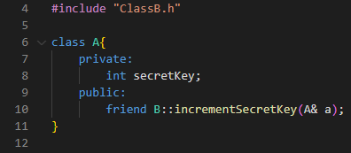
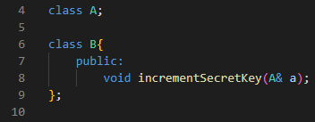
Friend of Classes
Do normal functions that are not part of a class have access to private members?
No
What are friend functions
Functions that have access to private members of a class but are not part of a class.
Can be either a stand alone function or part of another class.

Slide 44
Datatypes
What are the differences between the last two data types?
Primitive datatypes:
int
bool
float
User defined data types:
GA
Chromosome
Pointers to data types:
int*
Pointer to pointer to data types
int**
Chromosome**

Slide 45
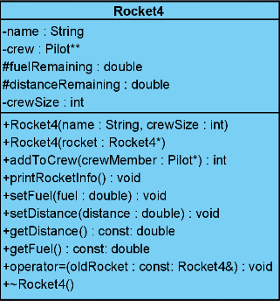
Exercise
Convert the following UML to an h file
Protected access specifier

Slide 46
Deep vs Shallow copy
Deep copy
Returns a pointer to a new block of memory containing the same values as the original object
Needs to be deleted separately
Usually created with clone or copy constructor functions
Involves the new keyword
Shallow copy
Returns a pointer to an already existing block of memory where the object can be found
Should only be deleted once
Multiple deletes can cause problems
Usually created by default assignment operators

Slide 47
Quiz: https://forms.gle/jHzKLAZ7LVjZR5Lt7

Slide 48
Question?

Slide 49
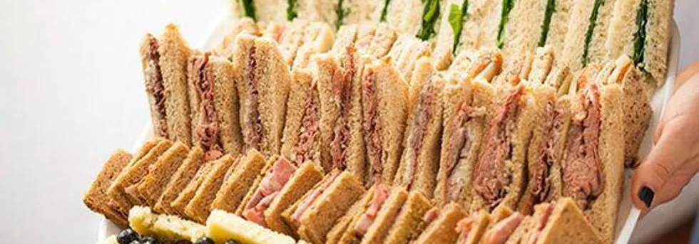
Break 2 - Sandwich time

Slide 50
COS110: EO1 Bootcamp
Session 3

Slide 51
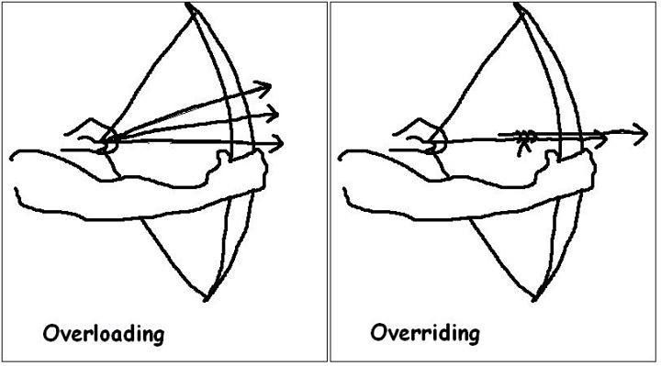
Admin
Ask questions
Participate in activities
Make notes
Have fun
Notes:
Slides will be released after the session

Slide 52
Content
Overloading
Operators
Operator Overloading
Pros and Cons
EO1 things
Examples
Tips and tricks

Slide 53
Before we start - this
What is the this pointer?
A pointer that points to the current object.
When do we need to use this pointer?
Usually when a parameter has the same name as a member variable
Why?
How do we use the this pointer?
this->variableName

Slide 54
Recap: What is overloading?
Same function name
Different implementations
How does the compiler distinguish between
Parameter types and orders
Why is it useful
Readability
Usability

Slide 55
What are operators?
Operators are symbols that perform operations on variables and values - Programmiz
Examples:
+
*
new
/
Default implementation is defined for primitive data types

Slide 56
What is operator overloading
Giving an operator different implementations for different types
Can operators be overloaded for primitive types?
No
https://en.cppreference.com/w/cpp/language/operators
Lists all the operators that can be overloaded

Slide 57
Structure of an operator overloading definition
Name the three components
Return type
Function name
Parameters
Class& operator=(Class& cs)
What does this look like?
Notes:
Function signatures => operator overloading is just another function

Slide 58
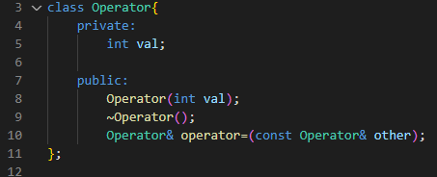
Exercise
Try to implement this as a deep copy constructor
Notes:
Try to implement this as a deep copy constructor

Slide 59
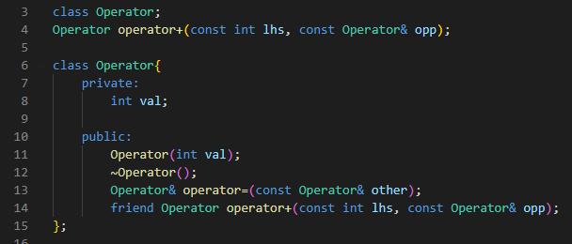
Combining operator overloading with friend functions
Friend keyword allows the operator to access what access specifier variables of both classes?

Slide 60
Tip for operator overloading
Think of them as normal functions
The declaration is the most difficult part
Make sure you know what the parameter types of each operator is for EO1

Slide 61
Pros and Cons of operator overloading
Pros
Convenient
Improves write-ability
Improves flexibility of code
Improves maintainability
Cons
Destroys readability
Example
+ decreases the value
- increases the value
Care has to be taken in the design of the function declaration
More on this in COS 333

Slide 62
Small aside - Runtime errors vs Compile time errors
Compile time errors:
Errors found by the compiler
Typically the following types of errors:
Syntax
Type
Linking
Circular dependencies
Will always appear
Run time errors:
Errors occurred during run time
Typical errors:
Seg faults
Null pointer exception
Double free
Infinite loop
Will only appear if that specific control path is followed
Theory Question: Can your ide detect runtime errors? More generally can a program A detect all the possible errors that can occur in program B within a finite amount of time.
Notes:
Halting problem
Compilation errors defined in COS341 - Compiler Construction

Slide 63
Tips for EO1
Practice writing code by hand
Ensure you remember your ; } { ( )
Ensure you have an intuitive understanding of the algorithm before learning the C++ syntax for it
Ensure your basic logic skills are up to scratch
Practise a few basic simple programs the days before your EO1
Learn as if it was a closed book test
Only use the textbook in the exam when you have no other choice
Redo your practicals as extra practise for EO1
You can even expand it to make the practicals more challenging

Slide 64
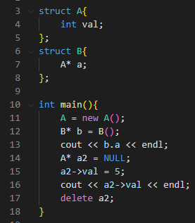
Example questions 1
List all of the errors in the following code and explain why

Slide 65
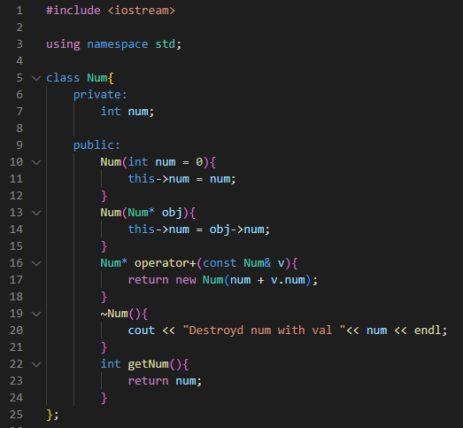
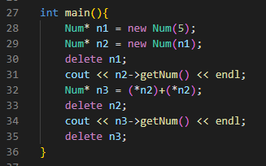
Example questions 2: What is the output
Notes:
Destroyd num with val 5
5
Destroyd num with val 5
10
Destroyd num with val 10

Slide 66
Example 3
Write the code that will create a dynamic 3d array consisting of dynamic number objects using the overwritten default constructor. Use the predefined constant variable “size” as the sizes of the array.
Hints:
What will the data type of the array be
How many for loops will there be
What constructor will you use
Notes:
Always perform null checks even when not asked

Slide 67
Example 4
Write the code that will deallocate a dynamic 3d array consisting of dynamic number objects. Use the predefined constant variable “size” as the sizes of the array.
Hints:
What will the data type of the array be
How many for loops will there be
What delete keyword will you use

Slide 68
Example 5
Explain how you would test to ensure a proper deep copy of a object has been made and why this would work? (2)

Slide 69
Example 6
Explain when it is appropriate to use the * operator and when to use the & when working with variables?
Give the equivalent operator combination for ->

Slide 70
Quiz: https://forms.gle/ETHzibTgUn2bbjue8

Slide 71
Questions

Slide 72
Thank you for attending :)

